Slide 1

TL_Exceeded
Team members:
J.L. Mansi
V. Sree Manjusha
Ch. Reshma
J. Hemanth Raj
T. Vamshi
Link to our web app developed using Machine Learning: https://crop--recommendation.herokuapp.com/

Slide 2
Outline
The Problem Statement
Solution Proposal
Technologies Used
Conclusion

Slide 3
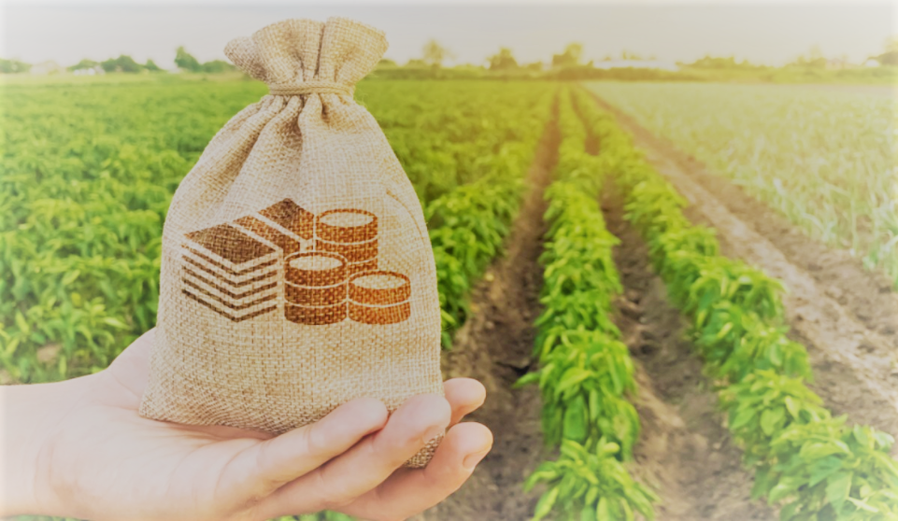
The Problem Statement :
To Maximize the agricultural yield of a particular field by
recommending appropriate crops for cultivation and also to diversify the idea of farming using machine learning algorithms.

Slide 4

Our Ideology behind choosing this problem statement :
What if agriculture can be made affordable by everyone?

Slide 5
OUR MACHINE LEARNING MODEL AIMS AT:
Encouraging every individual to contribute towards healing the world from technological sophistication by making agriculture affordable and easy.
Making a self sustaining world.
Luring everyone into agriculture and in making agriculture a secondary source of income.

Slide 6
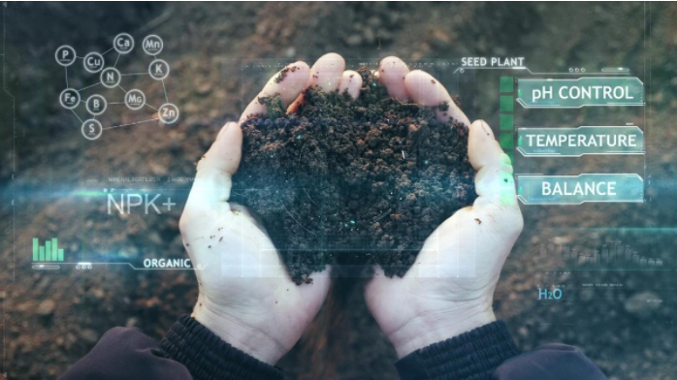
Description of Problem Statement:
We will be working on a dataset that would allow the users to build a predictive model to recommend the most suitable crops to grow in a particular farm based on various parameters.
The various parameters taken in consideration are :
N - the ratio of Nitrogen content in the soil,
P - the ratio of Phosphorus content in the soil,
K - the ratio of Potassium Content in the soil,
Temperature- temperature in degree Celsius,
Humidity - relative humidity in %,
ph - Represents pH value of the soil,
Rainfall - rainfall in mm

Slide 7

Solution Approach :
Step 1: Data pre-processing:
The missing values are handled, useful and relevant features are extracted and the data is split into training and test sets.
Step 2: Choosing and training the data with various classification algorithms:
We will be testing many classifiers for classification on training data and select the one that works best on training data and check their performance on test data.
Step 3: Finalizing a classification model based on its performance and predicting the suitable crop
The classification model with the highest accuracy is chosen and used with the testing data for prediction.
Step 4: Multiple crop prediction along with % of profit obtained on it
Prediction of multiple suitable crops along with the profit returns obtained on them , so that the farmer can choose a crop that is most suited to him.
Step 5 : Deploying the ML model to global web application, using flask and Heroku.
THE MOST SUITABLE CROPS ARE HENCE OBTAINED!
.

Slide 8
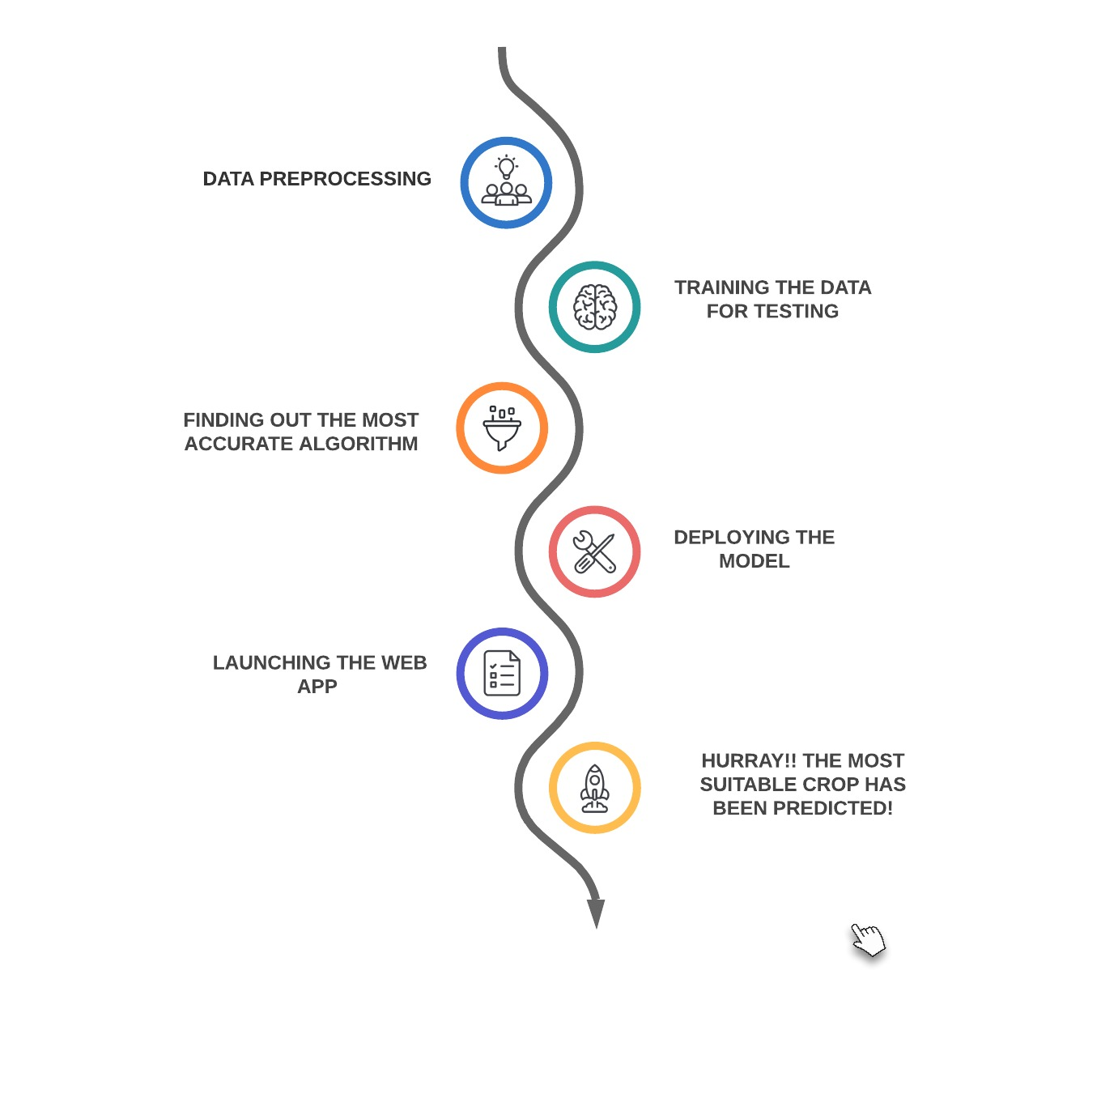
Solution approach to our Problem Statement

Slide 9
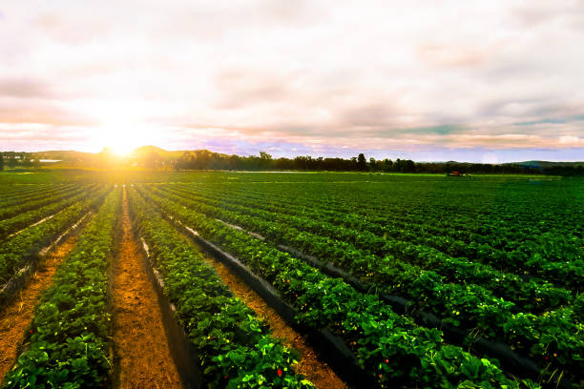

Feature Extraction
ML Techniques Training Data Testing Data
Crop Recommendation
DATA
PREDICT

Slide 10
Missing value handlings
DATA PROCESSING
Splitting of data into Training data and Testing data
Relevant Features Extraction

Slide 11
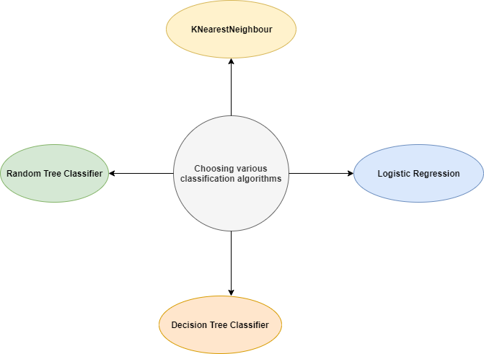
After testing the data with various algorithms, we found that K Nearest Neighbour classifier and Random forest classifier gives the maximum accuracy (0.91).But, since we wanted to predict 3 different crops none of these algos matched our requirements and so we decided to modify the class that can predict 3 crops by considering the euclidean distance between the data points. Hence using our own method we predicted 3 crops that can give similar results of yield and profits to the end user.

Slide 12
DEPLOYMENT OF THE ML MODEL
Creating the Pickle File
Writing the Flask file code ,which will create the web app of our model in a local server
Creating HTML,CSS files for the Frontend
Deploying our local server Web app into a global one using a platform as a service ‘’HEROKU’’
Hurray! The app link was generated.
Click on this for Crop Predictions

Slide 13
Technologies AND TOOLS Used :-
TECHNOLOGIES:
MACHINE LEARNING
PYTHON
FRONT END WEB D TECHNOLOGIES(HTML,CSS,JS)
FLASK
TOOLS:
SPYDER,GOOGLE COLAB
HEROKU

Slide 14
CONCLUSION
FROM OUR ML MODEL,WE HAVE PREDICTED THE PROFITABLE CROPS WHICH CAN BE CULTIVATED IN A LAND
WE HAVE PREDICTED 3 TYPES OF CROPS
IF ALL THE 3 PREDICTED CROPS ARE DIFFERENT THE USER HAS A FREEDOM OF CHOOSING HIS OWN
IF ONE OF THE PREDICTED CROPS ARE REPETITIVE THEN THE MOST DOMINANT ONE SHOULD BE CONSIDERED.
IF ALL THE THREE PREDICTED CROPS ARE SAME THEN , THAT CROP ITSELF IS THE SUITABLE TO OBTAIN MAXIMUM PROFIT
THUS WE CAN PREDICT THE MAXIMUM PROFITABLE AND SUITABLE CROP FOR THE GIVEN SOIL PARAMETERS.

Slide 15

OUR WORK :-
GITHUB LINK :: GITHUB LINK
WEB APP LINK :: WEB APP LINK

Slide 16
THANK YOU !

